Slide 1
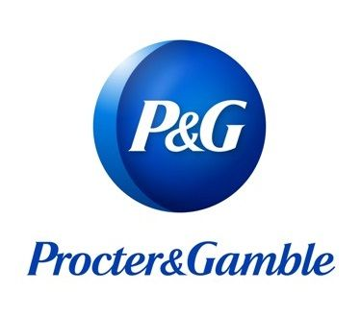
‘Touching Lives Improving Lives’
By Hemlata Kohin
Image taken from http://www.insideradio.com

Slide 2

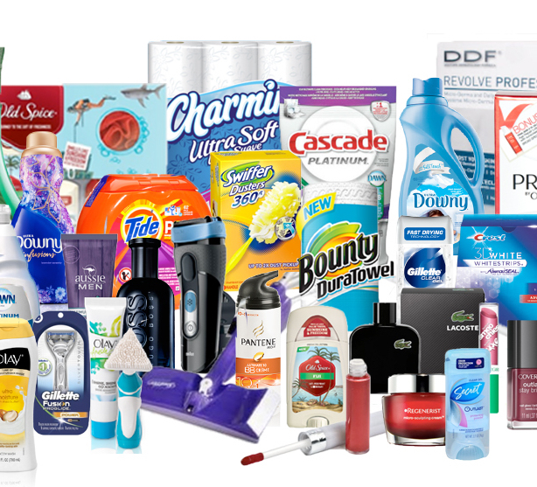
Overview
It specializes in a wide range of personal health/consumer health, and personal care and hygiene products.
P&G touches and improves the lives of around 5 billion people around the world. The world population itself is 7.5 Billion.

Slide 3
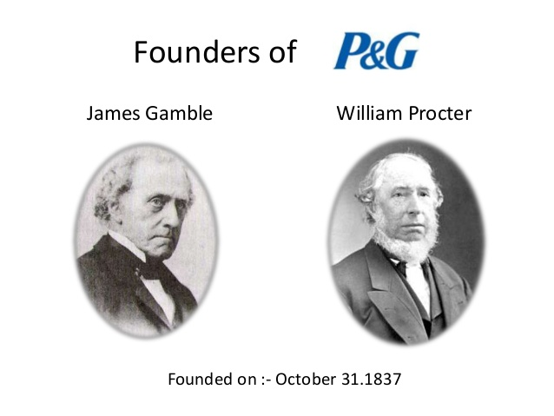
Brief history
The Procter & Gamble Company (P&G) is an American multinational consumer goods corporation headquartered in downtown Cincinnati, Ohio, founded in 1837 by English American William Procter and Irish American James Gamble.
Brothers in law William Procter and James Gamble started a partnership, making and selling candles and soap in Cincinnati.
Image taken from Slideshare.net

Slide 4
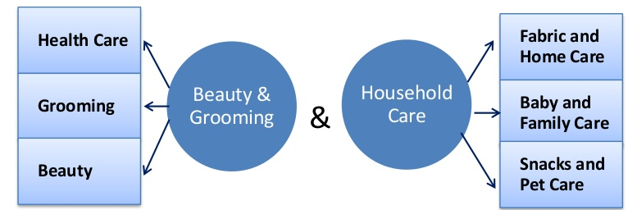
Company product portfolio

Slide 5
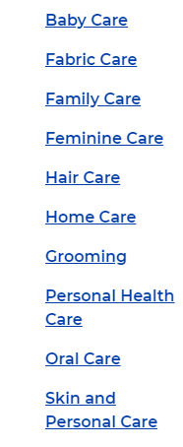
P&G is one of the largest and fastest-growing consumer goods companies in the United States, serving over 5 billion consumers worldwide.
P&G has another 25 manufacturing plants and 14 customer business centers located across the U.S.
It has its operations in about 80 countries. Having its manufacturing units in most countries. Its products are used in around 180 countries.

Slide 6
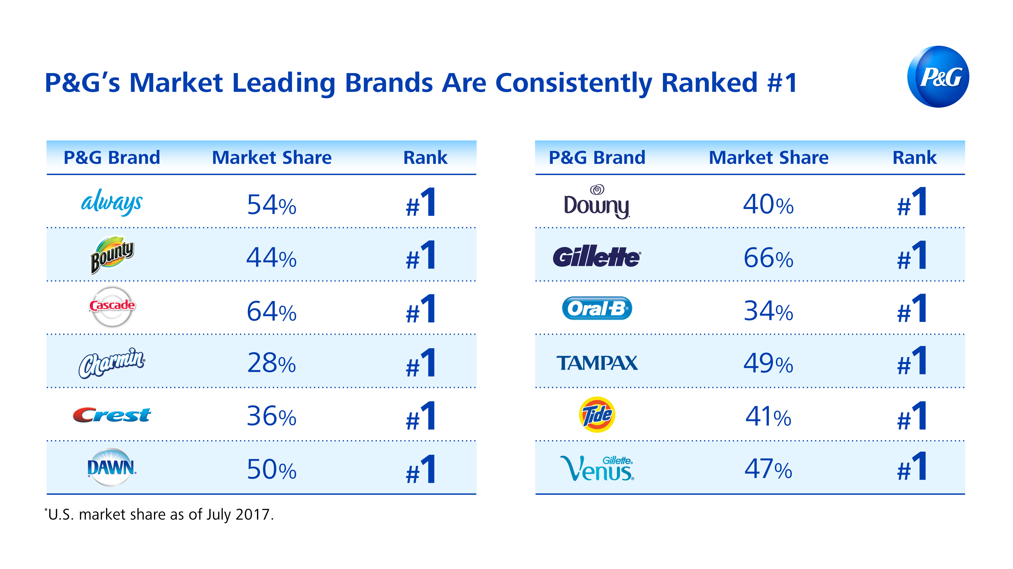

Slide 7
Facts & Figures
David S. Taylor is the current CEO
Procter & Gamble currently stands in the Fortune 500 list at Rank 45.
Revenue stands at $67.684 Billions for 2019.
It has its profits around $9750 Billions
It has assets worth $118,310 Billions
And there are currently 92,000+ employees serving worldwide
65 Years on Fortune 500 list ($5.6 Billion needed to be on the list)
It owns a total of 300 brands.

Slide 8
Strengths
Powerful collection of well known brands & well renowned products
Massive worldwide distribution network. Gross margin is 15 times the Industry average
Impressive and historically successful R&D efforts –Invests $2M

Slide 9
Weakness
Focus on high-end market.
Stiff competition from other high end brands
Growth hard to achieve when the company is this large & diversified

Slide 10
Opportunities
Can grow extensively in developing countries. Huge growth potential in Indian & Chinese markets.
Internet marketing & can grow online.
Going green & eco friendly.
Ex: Established in 1964, P&G India serves around 650 million consumers across India.

Slide 11
Threats
Fierce competitive landscape with competition from high valued brands such as Unilever Limited & Dabur.
Consumer price sensitivity, particularly in emerging markets.
Raw material costs keeps increasing leading to changes in the final product leading to change in peoples’ choices.
In the market many substitutes are available for P&G products at the cheaper prices.

Slide 12
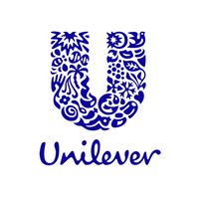

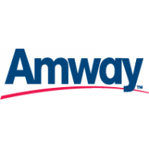

Intensity of rivalry
The intensity of rivalry is very high in this industry
P&G has very strong competitions from companies such as Amway Corporations, Palmotive, Colgate, Unilever, Kimberly-Clark, Nestle.

Slide 13
Awards & Recognition
Most Innovative Companies - Forbes
New Product Pacesetters - IRi Market Research Company
Top Companies for Executive Women - National Association for Female Executives
Most Reputable Companies (World & America) – Forbes
World’s Most Admired Companies – Fortune
Supply Chain Masters - Gartner, Global tech research company
And Many more !

Slide 14
Conclusion
Has all the leading household/Personal Care Products in the market
Sales have a consistent rate of around 66 billion U.S. dollars.
Major seller of Health and Beauty Care in the Market
Advertising in the United States and other countries has improved
P&G tripled its innovation success rate ($2 Billion/annum)

Slide 15
The end

